Slide 1
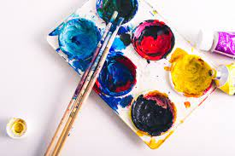


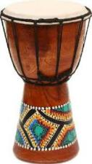



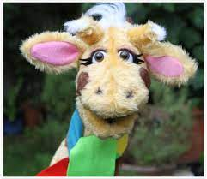
English
(Writing)
Fiction – Where the Wild Things Are
Drama, hot seating
Character descriptions
Retelling story
Using adjectives, conjunctions, verbs, adverbs and appropriate punctuation.
Spellings;
We will be using both Essential spelling and Little Wandle to help us spell words.
How do things change?
Y2 Autumn 1
Art
.
Self portraits in the style of Brianna McCarthy
Mix primary colours together. Use a variety of tools and techniques including different brush sizes.
Music - Music express
My body – ”Beat”
Computing - Getting started
Logging on, using tech for a purpose creating art, staying safe online
Trusting in God together, we live, learn and grow.
Where the Wild Things Are
Our value is “thankfulness”
(Reading)
Where the Wild Things are
Guided Reading groups
Individual reading
Science - What do I need to
grow?
Draw and label parts of the body
Talk about how animals have babies which grow into adults
Talk about basic needs of animals and people
Understand what the 5 senses are
RE - Creation
Why is the word God so important to Christians?
What do Christians believe God is like?
PE - Atlas Sports
Moving around the space safely
Understanding risks and when to take them
Supporting your body weight with your arms
Outdoor education
Rules of the woodland classroom
Maths
Place value
Recognising 10s and 1s
Counting in 10s
Partitioning
Writing numbers in words
Addition and subtraction
PSHE – SCARF
“Me and my relationships”
Classroom rules
Listening
Feelings
Our bodies
Good friends
History - How have I changed?
Understand how they have changed. Recognise changes in living memory. Understand the terms past, present and future

