Slide 1
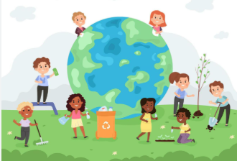
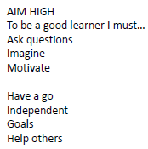


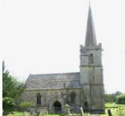
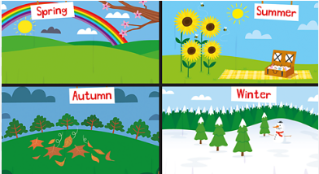
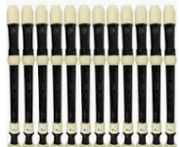


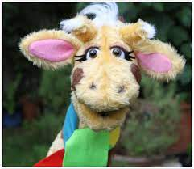
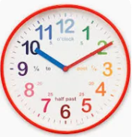

English
(Writing)
Fiction – Malala’s Magic Pencil
Drama, hot seating, story maps
Retelling story
Using ‘when’ and ‘because’ as subordinating conjunctions
Questions
Innovating a story
Non-fiction
Letter writing
Spellings;
We will be using both Essential spelling and Little Wandle to help us spell words.
How can we take care of our world?
Y2 Summer 1
Art
Mix primary colours
Artist – Wassily Kandinsky
Printing – seasonal change pictures using light and texture
Computing – Moving a robot
Programming Bee bots
Online safety – Digi duck’s famous friend – reliability
Trusting in God together, we live, learn and grow.
Our value is “Service”
Science – Seasons and changes
Weather across seasons
Describe how day length varies
(Reading)
Whole class guided reading
Reading for pleasure – The boy who grew dragons
Individual reading
RE – Special places
What places are special to Christians and Muslims
Music –
Whole class recorders
Geography – how can we take care of our woodland classroom?
Physical features in our local area
Maths
Fractions
Measurement – time
PSHE – SCARF
“Being my best”
PE - Atlas Sports
Principles of Play – throwing, catching, use tactic in a game, play competitive games

Slide 2
Number – fractions
Pupils should be taught to: recognise, find, name and write fractions 1/3 , 1/4, 2/4 and 3/4 of a length, shape, set of objects or quantity write simple fractions for example, 1/2 of 6 = 3 and recognise the equivalence of 2/4 and 1/2.
Measurement -compare and sequence intervals of time tell and write the time to five minutes, including quarter past/to the hour and draw the hands on a clock face to show these times know the number of minutes in an hour and the number of hours in a day.
Geography –
identify seasonal and daily weather patterns in the United Kingdom and the location of hot and cold areas of the world in relation to the Equator and the North and South Poles
use basic geographical vocabulary to refer to:
key physical features, including: beach, cliff, coast, forest, hill, mountain, sea, ocean, river, soil, valley, vegetation, season and weather
key human features, including: city, town, village, factory, farm, house, office, port, harbour and shop
use aerial photographs and plan perspectives to recognise landmarks and basic human and physical features; devise a simple map; and use and construct basic symbols in a key
use simple fieldwork and observational skills to study the geography of their school and its grounds and the key human and physical features of its surrounding environment.
Computing:
understand what algorithms are; how they are implemented as programs on digital devices; and that programs execute by following precise and unambiguous instructions
create and debug simple programs
use logical reasoning to predict the behaviour of simple programs
use technology safely and respectfully, keeping personal information private; identify where to go for help and support when they have concerns about content or contact on the internet or other online technologies.
Science:
observe changes across the four seasons
observe and describe weather associated with the seasons and how day length varies.
Working scientifically
asking simple questions and recognising that they can be answered in different ways
observing closely, using simple equipment
performing simple tests
identifying and classifying
using their observations and ideas to suggest answers to questions
gathering and recording data to help in answering questions
Art:
to use a range of materials creatively to design and make products
to use drawing, painting and sculpture to develop and share their ideas, experiences and imagination
to develop a wide range of art and design techniques in using colour, pattern, texture, line, shape, form and space
about the work of a range of artists, craft makers and designers, describing the differences and similarities between different practices and disciplines, and making links to their own work

