Slide 1
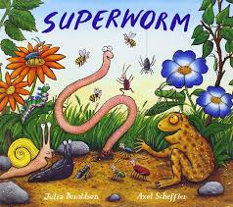
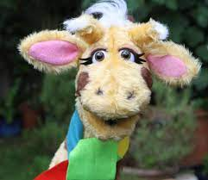


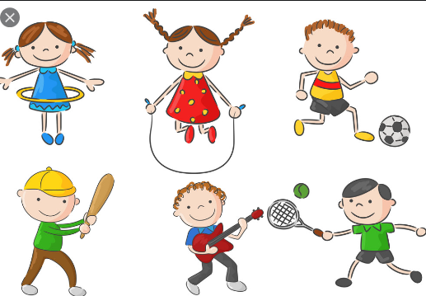
Come outside!
English
Reading and writing – Curious Quest
Phonics – Phase 3 and 4
Writing –
Writing short phrases and sentences
Handwriting
Transcribed/guided writing
CP – message centre
Understanding the world
Comparing and observing change/weather across the 4 seasons.
Looking at familiar geographical features in their local area.
Exploring the lives of old kings and queens.
Woodland classroom
Value this term: service
Reception
Trusting in God together, we live,
learn and grow.
Communication and Language
Encourage clear speech and articulation
Use descriptive language/ words
Give explanations retell stories/ say rhymes
Developing their voice in group discussions
Using language to articulate feelings
Maths
Reception - Numbers to 20 and beyond
1 more, 1 less and taking away.
Missing numbers
Estimating
Matching
Shapes.
Expressive art design
Art inspired by Kandinsky.
Recreating paintings, exploring shapes, colours and line work.
Collages, paintings, drawings and baking.
Music - weather
Percussion
Starting and stopping
Keeping a steady beat
Copying rhythms
Using different voices and volumes
Using percussion instruments
PSHCE – SCARF
”Being my best”.
Healthy eating
Keeping clean
Germs
Praise
Learning new things
Physical Development
Threading and sorting.
Tracing and making patterns.
Pencil control. Scissor control.
Construction. Playdough
Pattern pins, Tweezers
P.E. - Atlas Sports
Athletics
R.E
Which places are special in religion and why? What makes some places sacred to believers?
Do all believers share the same sacred places?
Looking at our termly value and some Bible stories.
Role play
King and queen dress up
”garden centre café/library”

Slide 2
EYFS Skills – Summer term 1
We are working on these skills this term
Communication and Language
Use new vocabulary in different contexts
Describe events in detail
Use talk to help solve problems and organise thinking.
Develop social phrases
Engage in story times
Listen to and talk about stories to build familiarity and understanding
Learn poems, rhymes and songs
Personal, Social and Emotional Development
Show an understanding of their feelings and those of others.
Give focussed attention to tasks
Respond to instructions
Work co-operatively and take turns.
Understanding the World
Understand some aspects of the past through stories.
Describe aspects of the environment using knowledge from stories, maps, pictures.
Explore and observe things in the natural world.
Talk about processes and changes.
Physical Development
Negotiate space and obstacles safely.
Demonstrate strength, balance and co-ordination.
Move energetically.
Fine Motor skills
Hold a pencil effectively
Use a range of small tools effectively.
Show increasing accuracy and care in drawing/painting
Mathematics
Have a deep understanding of number to 10 including the composition of each number.
Subitise up to 5.
Automatically recall number bonds to 5.
Verbally count beyond 20.
Explore and describe patterns in numbers including odds and evens
Literacy
Use and demonstrate understanding of new vocabulary
Learn and re-tell stories, poems and rhymes.
Read aloud simple words/sentences.
Form letters correctly.
Write simple phrases and sentences that can be read by others.
Expressive Arts and Design
Sing and perform rhymes and poems
Safely use and explore a range of materials, tools and techniques.
Make use of props and materials in role-play.

