Slide 1

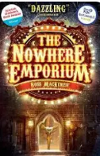
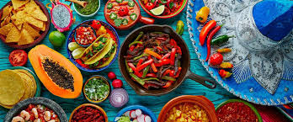
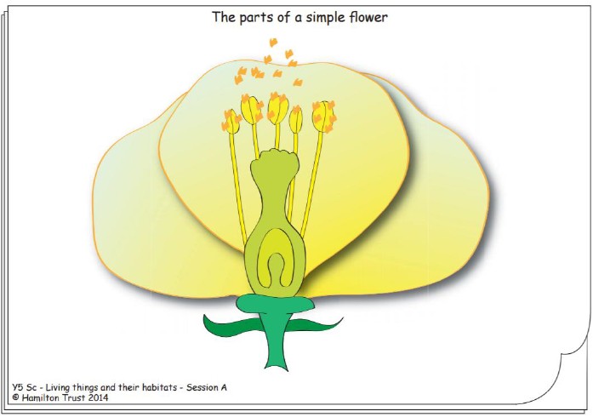
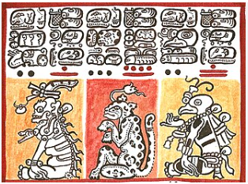
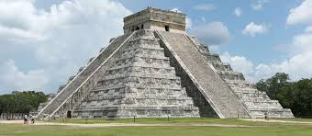
Maths
We will be learn about the relationships between fractions, decimals and percentages before moving on to ratio then shape and angles of shapes.
If you would like to support your child with this topic at home, BBC Bitesize have some good resources.
Aim High
To be a good learner I must…
Ask questions
Imagine
Motivate
Have a go
Independent
Goals
Help others
SATS
The Year 6 SATS are in week 5 of this term. The children will spend some time revising in class ahead of the tests. If you would like to support your child to practice at home CPG have free 10-minute tests on their website.
During SATS week the Year 5s will be doing a project focuses on our history.
Trusting in God together, we live, learn and grow
Our value this term is Service
English
Our book this term is The Nowhere Emporium by Ross MacKenzie.
We will be basing our writing on a short animation ‘Germans in the Woods’ and will be focusing on using dialogue to move stories forwards and using the active and passive voice. At the end of term the children will use their history knowledge to write a non-chronological report on the Mayas.
DT
In DT the class will be researching, planning and making some Mexican food.
RE
Why is the Torah so important to Jewish people?
This term we will be learning about Judaism and what roll the Torah plays in worship and everyday life.
History
This term we will be exploring the ancient Mayan civilization. The children will be learning about how Mayans lived, worshiped, celebrated and how their civilization came to an end.
Art
We have two art projects this term. The children will be making their own Mayan hieroglyphs using a variety of printing methods and then making with own Mayan chocolate pot out of clay.
PHSE – Being my Best
We’re learning to set goals and develop positive strategies to help us achieve our potential, through a growth mindset approach. We’re also learning about how to take care of ourselves, physically – including good hygiene, healthy eating and sleep routines.
Science
Our science topic is ‘Does everything start as an egg?’
The children will be learning about life cycles in plants and animals.
PE
This term the children will be swimming on a Tuesday afternoon.
Computing
Selection in quizzes.

Slide 2
National Curriculum links
Science
Content
describe the differences in the life cycles of a mammal, an amphibian, an insect and a bird
describe the life process of reproduction in some plants and animals
Working scientifically
planning different types of scientific enquiries to answer questions, including recognising and controlling variables where necessary
ii. taking measurements, using a range of scientific equipment, with increasing accuracy and precision, taking repeat readings when appropriate
iii. recording data and results of increasing complexity using scientific diagrams and labels, classification keys, tables, scatter graphs, bar and line graphs
iv. using test results to make predictions to set up further comparative and fair tests
v. reporting and presenting findings from enquiries, including conclusions, causal relationships and explanations of and degree of trust in results, in oral and written forms such as displays and other presentations
vi. identifying scientific evidence that has been used to support or refute ideas or arguments
PE
Swimming:
There are three main objectives for children to cover during this time, concerning:
- swimming ‘competently, confidently and proficiently over a distance of at least 25 metres’
- using ‘a range of strokes effectively’
- performing ‘safe self-rescue in different water-based situations’
Computing
design, write and debug programs that accomplish specific goals, including controlling or simulating physical systems; solve problems by decomposing them into smaller parts
use sequence, selection, and repetition in programs; work with variables and various forms of input and output
use logical reasoning to explain how some simple algorithms work and to detect and correct errors in algorithms and programs
select, use and combine a variety of software (including internet services) on a range of digital devices to design and create a range of programs, systems and content that accomplish given goals, including collecting, analysing, evaluating and presenting data and information
DT
Design: generate, develop, model and communicate their ideas through discussion, annotated sketches, cross-sectional and exploded diagrams, prototypes, pattern pieces and computer-aided design
Make: select from and use a wider range of tools and equipment to perform practical tasks
Evaluate: evaluate their ideas and products against their own design criteria and consider the views of others to improve their work
Nutrition: to understand and apply the principles of a healthy and varied diet. Prepare and cook a variety of predominantly savoury dishes using a range of cooking techniques. Understand seasonality, and know where and how a variety of ingredients are grown, reared, caught and processed.
Art
Generating Ideas:
Generate ideas from a range of stimuli and carry out simple research and evaluation to develop their ideas and plan more purposefully for an outcome.
Using Sketchbooks:
Use sketchbooks for a wider range of purposes for example ,drawing, planning.
Making Skills:
Demonstrate greater skill and control when drawing and painting to depict forms, such as showing an awareness of perspective and being able to create 3D effects.
To improve their mastery of art and design techniques, including drawing, painting and sculpture with a range of materials [for example, pencil, charcoal, paint, clay]
History
Pupils should be taught about: a non-European society that provides contrasts with British history – one study chosen from: early Islamic civilization, including a study of Baghdad c. AD 900; Mayan civilization c. AD 900; Benin (West Africa) c. AD 900-1300.

