Slide 1


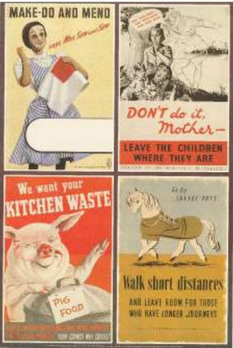
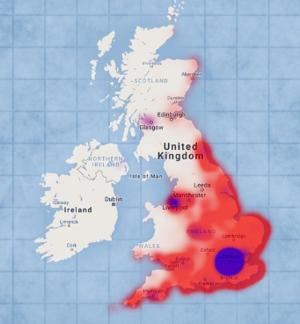
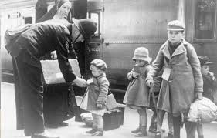

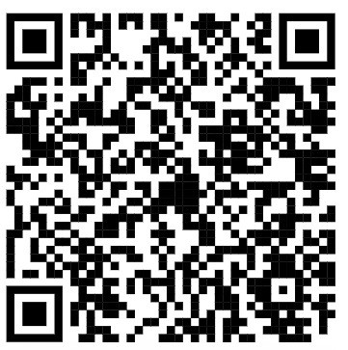
English:
Our book this term is Letters from
the Lighthouse by Emma Carroll.
Basing our learning on this text, the
class will be writing a range of pieces including wanted posters, stories and letters. Our grammar focus will be on using dialogue to advance action, using the active and passive voice, moving the position of subordinate clause using commas, using modal verbs.
Aim High
To be a good learner I must…
Ask questions
Imagine
Motivate
Have a go
Independent
Goals
Help others
PE:
This half term children will be doing tag rugby with Atlas on a Monday afternoon.
Trusting in God together, we live, learn and grow
Our value this term is: Trust
History:
We will be learning about WW2 this term, focusing on what life was like in Britian during this period. The class will be learning about rationing, the changing role of women, children and evacuation, the London Blitz and other bombings.
Art:
The children will create a sculpture of a lighthouse using cardboard and paper. We will also be examining WW2 posters and then designing our own.
Maths:
We will be focusing on fractions this term. If you would like to support your child in their maths at home, I can recommend this book:
And the BBC have a good section on fractions here:
Geography: Where did the bombs fall in WW2?
Using maps, the class will investigate which parts of Britain were targeted by bombing raids during WW2.
Computing:
We will be continuing to learn about internet safety and looking at search engines.
· How can search engines be used to find the correct information?
· What are reliable sources of information?
· Can everything we read on the internet be trusted?
RE: Why do Christians believe Jesus is the messiah?
We will be exploring what the term messiah means, why Jesus is an ‘unlikely’ messiah, and why Christians believe that Jesus’ life and the resurrection is so important in supporting this claim.
Homework:
Please support your child to keep up their learning at home. Each week all children should be
Reading
Completing Mangahigh Maths
Practice their timetables
Practicing their spellings

Slide 2
National Curriculum links
Art
Pupils should be taught to develop their techniques, including their control and their use of materials, with creativity, experimentation and an increasing awareness of different kinds of art, craft and design. Pupils should be taught: ▪ to create sketch books to record their observations and use them to review and revisit ideas ▪ to improve their mastery of art and design techniques, including drawing, painting and sculpture with a range of materials [for example, pencil, charcoal, paint, clay] ▪ about great artists, architects and designers in history.
PE
· Choose and combine techniques in game situations (running, throwing, catching, passing, jumping and kicking, etc.).
· Choose the most appropriate tactics for a game.
· Uphold the spirit of fair play and respect in all competitive situations.
· Lead others when called upon and act as a good role model within a team.
Science
compare and group together everyday materials on the basis of their properties, including their solubility and response to magnets
know that some materials will dissolve in liquid to form a solution, and describe how to recover a substance from a solution
use knowledge of solids, liquids and gases to decide how mixtures might be separated, including through filtering, sieving and evaporating
demonstrate that dissolving, mixing and changes of state are reversible changes
explain that some changes result in the formation of new materials, and that this kind of change is not usually reversible, including changes associated with burning and the action of acid on bicarbonate of soda
planning different types of scientific enquiries to answer questions, including recognising and controlling variables where necessary
taking measurements, using a range of scientific equipment, with increasing accuracy and precision, taking repeat readings when appropriate
recording data and results of increasing complexity using scientific diagrams and labels, classification keys, tables, scatter graphs, bar and line graphs
using test results to make predictions to set up further comparative and fair tests
reporting and presenting findings from enquiries, including conclusions, causal relationships and explanations of and degree of trust in results, in oral and written forms such as displays and other presentations
identifying scientific evidence that has been used to support or refute ideas or arguments
Computing
Use search technologies effectively, appreciate how results are selected and ranked, and be discerning in evaluating digital content
Select, use, and combine a variety of software (including internet services) on a range of digital devices to design and create a range of programs, systems, and content that accomplish given goals, including collecting, analysing, evaluating, and presenting data and information.
use technology safely, respectfully, and responsibly; recognise acceptable/unacceptable behaviour.
Managing information online
I can navigate online content, websites, or social media feeds using more sophisticated tools to get to the information I want (e.g. menus, sitemaps, breadcrumb-trails, site search functions). (11-14)
Copyright and ownership
I can explain why copying someone else’s work from the internet without permission can cause problems.
I can give examples of what those problems might be.
When searching on the internet for content to use, I can explain why I need to consider who owns it and whether I have the right to reuse it.
I can give some simple examples.
I can assess and justify when it is acceptable to use the work of others.
I can give examples of content that is permitted to be reused.
I can demonstrate the use of search tools to find and access online content which can be reused by others.
I can demonstrate how to make references to and acknowledge sources I have used from the internet.
I can explain the principles of fair use and apply this to case studies. (11-14)

