Slide 1

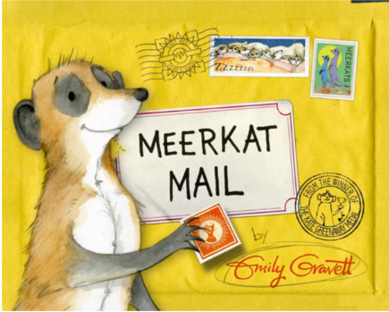


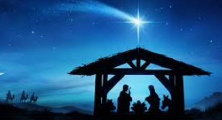

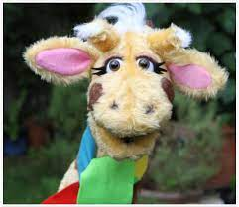
English
(Writing)
Fiction – Meerkat Mail
Drama, hot seating, story maps
Character descriptions
Retelling story
Using adjectives, conjunctions, verbs, adverbs and appropriate punctuation.
Non-fiction writing
Spellings;
We will be using both Essential spelling and Little Wandle to help us spell words.
What is it like where we live?
Y2 Autumn 2
Art
.
Digital art using cameras, painting
Focus artist: George Surat
DT – Textiles – making pouches
Cut, shape and join fabrics
Use basic sewing techniques
Simple finishing techniques to improve appearance
Computing – Digital painting
Create images using painting and drawing software
Trusting in God together, we live, learn and grow.
Meerkat Mail
Our value is “trust”
(Reading)
Meerkat Mail
Guided Reading groups
Individual reading
Science – Animal habitats
Basic needs for plants and animals
Different types of habitats
Why plants and animals live in certain habitats
Changes to habitats
RE - Incarnation
Why is Christmas special to Christians?
Music –
Singing – Christmas production
Maths
Addition and subtraction
Shape
Recognising 2D and 3D shapes
Lines of symmetry
Edges, faces, vertices
Geography – what is it like where I live?
Human and physical features of Haresfield, simple mapping.
Hot and cold areas of the world – Kalahari desert
Seasonal weather
PSHE – SCARF
“Valuing difference”
What makes us who we are?
My special people
Acts of kindness
Solving problems
PE - Atlas Sports
Principles of play
Outdoor education
Rules of the woodland classroom

Slide 2
Number - addition and subtraction
Pupils should be taught to: read, write and interpret mathematical statements involving addition (+), subtraction (−) and equals (=) signs represent and use number bonds and related subtraction facts within 20 add and subtract one-digit and two-digit numbers to 20, including 0 solve one-step problems that involve addition and subtraction, using concrete objects and pictorial representations, and missing number problems such as 7 = ? − 9
Geography: Human and physical geography - identify seasonal and daily weather patterns in the United Kingdom and the location of hot and cold areas of the world in relation to the Equator and the North and South Poles, use basic geographical vocabulary to refer to: key physical features, including: beach, cliff, coast, forest, hill, mountain, sea, ocean, river, soil, valley, vegetation, season and weather, key human features, including: city, town, village, factory, farm, house, office, port, harbour and shop
Geometry - properties of shapes
Pupils should be taught to:
recognise and name common 2-D and 3-D shapes, including:
  2-D shapes [for example, rectangles (including squares), circles and triangles]
  3-D shapes [for example, cuboids (including cubes), pyramids and spheres]
Science:
identify that most living things live in habitats to which they are suited and describe how different habitats provide for the basic needs of different kinds of animals and plants, and how they depend on each other;
identify and name a variety of plants and animals in their habitats, including microhabitats; describe how animals obtain their food from plants and other animals, using the idea of a simple food chain, and identify and name different sources of food.
DT
Design purposeful, functional, appealing products for themselves and other users based on design criteria.
Select from and use a range of tools and equipment to perform practical tasks [for example, cutting, shaping, joining and finishing.
Evaluate their ideas and products against design criteria.
Art:
about the work of a range of artists, craft makers and designers, describing the differences and similarities between different practices and disciplines, and making links to their own work.
Computing:
use technology purposefully to create, organise, store, manipulate and retrieve digital content.

