Slide 1
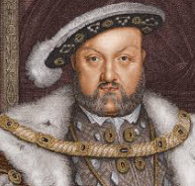
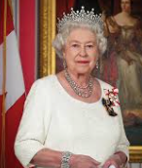
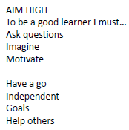

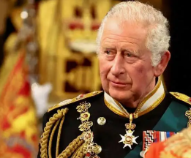


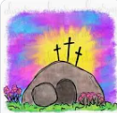


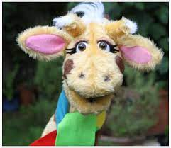

English
(Writing)
Fiction – Ocean Meets Sky
Drama, hot seating, story maps
Retelling story
Using ‘and’ as a conjunction
Expanded noun phrases
Innovating a story
Spellings;
We will be using both Essential spelling and Little Wandle to help us spell words.
Who were the Kings and Queens of England?
Y2 Spring 2
Art
Drawing – investigating tone
Bridget Riley
Collage textiles
DT
Levers
Computing – Grouping Data
Sorting and grouping objects
Trusting in God together, we live, learn and grow.
Our value is “justice”
Science – How does your garden grow?
Identify and name plants and trees
Describe how seeds and bulbs change over time
(Reading)
Whole class guided reading – Fantastic Mr Fox
Individual reading
RE – Salvation
Why is Easter special for Christians?
Who is a Muslim and how do they live?
Music –
Listen to and describe music linked to water
History – Who were the Kings and Queens of England?
Henry VIII, Elizabeth I and II
Geography – name countries and capital cities of United Kingdom
Maths
Multiplication and Division
Measurement – length and height, mass, capacity and temperature
PSHE – SCARF
“Rights and Respect”
PE - Atlas Sports
Healthy Happy Heart

Slide 2
Number - multiplication and division
Pupils should be taught to: recall and use multiplication and division facts for the 2, 5 and 10 multiplication tables, including recognising odd and even numbers calculate mathematical statements for multiplication and division within the multiplication tables and write them using the multiplication (×), division (÷) and equals (=) signs show that multiplication of 2 numbers can be done in any order (commutative) and division of 1 number by another cannot solve problems involving multiplication and division, using materials, arrays, repeated addition, mental methods, and multiplication and division facts, including problems in contexts
Measurement - choose and use appropriate standard units to estimate and measure length/height in any direction (m/cm); mass (kg/g); temperature (°C); capacity (litres/ml) to the nearest appropriate unit, using rulers, scales, thermometers and measuring vessels compare and order lengths, mass, volume/capacity and record the results using >, < and =
History –
Pupils should be taught about:
the lives of significant individuals in the past who have contributed to national and international achievements. Some should be used to compare aspects of life in different periods [for example, Elizabeth I and Queen Victoria, Christopher Columbus and Neil Armstrong, William Caxton and Tim Berners-Lee, Pieter Bruegel the Elder and LS Lowry, Rosa Parks and Emily Davison, Mary Seacole and/or Florence Nightingale and Edith Cavell]
significant historical events, people and places in their own locality.
Geography –
name, locate and identify characteristics of the four countries and capital cities of the United Kingdom and its surrounding seas.
Science:
Identify and name a variety of common wild and garden plants, including deciduous and evergreen trees
identify and describe the basic structure of a variety of common flowering plants, including trees.
Working scientifically
asking simple questions and recognising that they can be answered in different ways
observing closely, using simple equipment
performing simple tests
identifying and classifying
using their observations and ideas to suggest answers to questions
gathering and recording data to help in answering questions
Computing:
use technology purposefully to create, organise, store, manipulate and retrieve digital content.
Art:
▪ to use a range of materials creatively to design and make products ▪ to use drawing, painting and sculpture to develop and share their ideas, experiences and imagination ▪ to develop a wide range of art and design techniques in using colour, pattern, texture, line, shape, form and space ▪ about the work of a range of artists, craft makers and designers, describing the differences and similarities between different practices and disciplines, and making links to their own work

