Slide 1
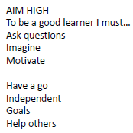
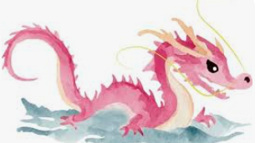

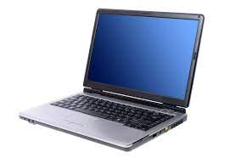





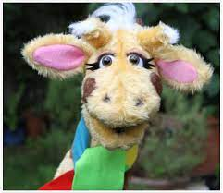

English
(Writing)
Fiction –
Drama, hot seating, story maps
Character descriptions
Retelling story
Using adjectives, conjunctions, verbs, adverbs and appropriate punctuation.
Non-fiction writing – Mary Seacole
Features of non-fiction books
Diary writing
Spellings;
We will be using both Essential spelling and Little Wandle to help us spell words.
How can I keep myself healthy?
Y2 Spring 1
Art
3D clay sculptures
Water colour painting Chinese dragons
Computing – Digital music
Create music using software
Trusting in God together, we live, learn and grow.
Our value is “perseverence”
Science – Staying healthy
The importance of exercise, healthy eating and hygiene
(Reading)
Whole class guided reading – The Owl who was afraid of the dark
Individual reading
RE – Being special
Where do we belong? Who is a Muslim and how do they live?
Music –
Listen to and describe music linked to weather
History – Nurturing Nurses
Florence Nightingale, Mary Seacole and Edith Cavell
Maths
Money
Multiplication and Division
PSHE – SCARF
“Staying Safe”
PE - Atlas Sports
Gymnastics

Slide 2
Number - multiplication and division
Pupils should be taught to: recall and use multiplication and division facts for the 2, 5 and 10 multiplication tables, including recognising odd and even numbers calculate mathematical statements for multiplication and division within the multiplication tables and write them using the multiplication (×), division (÷) and equals (=) signs show that multiplication of 2 numbers can be done in any order (commutative) and division of 1 number by another cannot solve problems involving multiplication and division, using materials, arrays, repeated addition, mental methods, and multiplication and division facts, including problems in contexts
Measurement - Money recognise and use symbols for pounds (£) and pence (p); combine amounts to make a particular value find different combinations of coins that equal the same amounts of money solve simple problems in a practical context involving addition and subtraction of money of the same unit, including giving change
History –
Pupils should be taught about:
the lives of significant individuals in the past who have contributed to national and international achievements. Some should be used to compare aspects of life in different periods [for example, Elizabeth I and Queen Victoria, Christopher Columbus and Neil Armstrong, William Caxton and Tim Berners-Lee, Pieter Bruegel the Elder and LS Lowry, Rosa Parks and Emily Davison, Mary Seacole and/or Florence Nightingale and Edith Cavell]
Science:
describe the importance for humans of exercise, eating the right amounts of different types of food, and hygiene
Working scientifically
asking simple questions and recognising that they can be answered in different ways
observing closely, using simple equipment
performing simple tests
identifying and classifying
using their observations and ideas to suggest answers to questions
gathering and recording data to help in answering questions
Computing:
use technology purposefully to create, organise, store, manipulate and retrieve digital content.
Art:
▪ to use a range of materials creatively to design and make products ▪ to use drawing, painting and sculpture to develop and share their ideas, experiences and imagination ▪ to develop a wide range of art and design techniques in using colour, pattern, texture, line, shape, form and space ▪ about the work of a range of artists, craft makers and designers, describing the differences and similarities between different practices and disciplines, and making links to their own work

