Slide 1


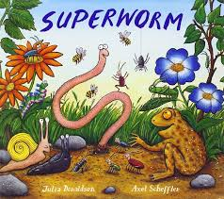
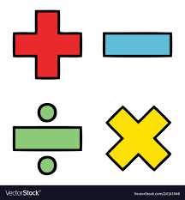
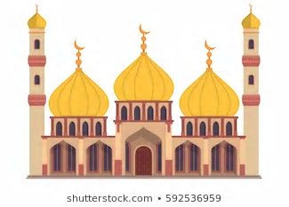
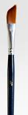
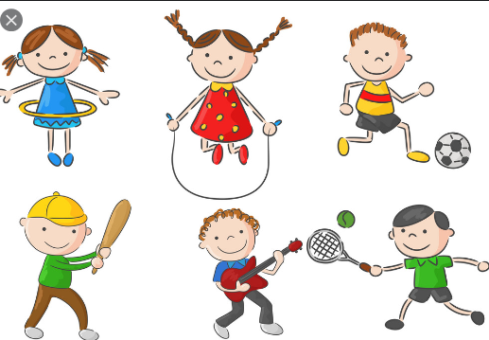
Literacy
Reading –
Curious Quests texts
Little Wandle texts – 1:1 and GR
Phase 5 words/sounds/tricky words in phonic sessions
Alien words
Writing – Curious Quest
Stories, letters, recounts
Captions and labels
Writing common exception words
Writing with phase 5 phonics
Handwriting practice
Use ‘and’ as a conjunction and in a list
Apply suffixes correctly
Come outside!
Music - weather
Percussion
Starting and stopping
Keeping a steady beat
Copying rhythms
Using different voices and volumes
Using percussion instruments
Value this term: service
Year 1
Trusting in God together, we live,
learn and grow.
History
Exploring the lives of old kings
and queens
Geography
Looking at familiar geographical
features in their local area.
Woodland classroom
Maths
Counting in 2’s, 5’s and 10’s.
Doubles, equal groups, halving, quartering, arrays and sharing.
Computing
Beeboots and coding
Trouble shooting
Science
Comparing and observing change/weather across the 4 seasons.
Woodland classroom
PSHCE – SCARF
”Being my best”.
Healthy eating
Keeping clean
Germs
Praise
Learning new things
Art/DT
Art inspired by Kandinsky.
Recreating paintings, exploring shapes, colours and line work.
baking.
PE – Atlas sports
Athletics
R.E
Which places are special in religion and why? What makes some places sacred to believers? Do all believers share the same sacred places?
Looking at our termly value and some Bible stories.

