Slide 1


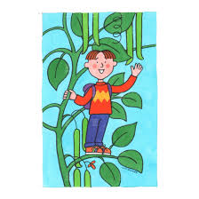


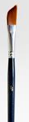
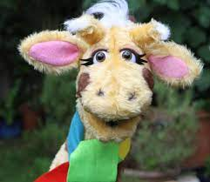
English
English - Drawing club
Non-fiction -
Scientific/Geog themed writing
Fiction –
Character descriptions
Re-telling story
Story innovations
SPAG
Add verbs using -ing, -ed
complete sentences, accurate tense, adjectives, nouns, correct spelling on tricky words
Ready, steady, GROW!
Science
Identify and label trees, plants, seeds and bulbs
Know the things plants need to grow and how they change over time
Woodland classroom
Geography
What are the different countries in the UK and what do the flags look like?
Year 1
Value this term: Justice
PSHCE / SCARF
Rights and respect
Looking after money
behaviour
Helping others and being better
Taking care of things
Basic first aid
Computing
Online safety
Maths
Counting on
Subtraction
Missing numbers
Count in 10’s
Estimate on a number line
Compare length and height
Mass and volume
Doubles
D.T.
Making a moving card using slots and leavers.
Role play
Giants’ library
RE
Why is Easter special for
Christians?
Art
Shading, pencil control, paintings, drawings and tissue paper flowers.
Music
Composition – Jack and
The Beanstalk themed music and songs.
P.E. - Atlas Sports
Dodge ball
Woodland classroom

