Slide 1



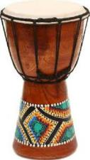



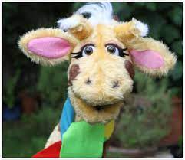
English
(Writing)
Non-fiction
Writing labels, captions, lists, simple sentences and descriptions
Fiction – Drawing Club (until Autumn 1)
Using adjectives, conjunctions, verbs, adverbs and appropriate punctuation.
CP – message centre
Phonics
Revise Phase 3 and phase 4
Begin phase 5
Tricky words
How do things change?
Y1 Autumn 1
Art
Eric Carle style paintings.
self portraits in the style of Brianna McCarthy
Mix primary colours together. Use a variety of tools and techniques including different brush sizes.
Music - Music express
My body – ”Beat”
Computing - Getting started
Logging on, using tech for a purpose creating art, staying safe online
Trusting in God together, we live, learn and grow.
The Very Hungry Caterpillar
Our value is “thankfulness”
(Reading)
Where the Wild things are
Other drawing club texts
Phase 3-5 Letters and Sounds
Guided Reading groups
Individual reading
Science - What do I need to
grow?
Draw and label parts of the body
Talk about how animals have babies which grow into adults
Talk about basic needs of animals and people
Understand what the 5 senses are
RE - Creation
Why is the word God so important to Christians?
What do Christians believe God is like?
PE - Atlas Sports
Moving around the space safely
Understanding risks and when to take them
Supporting your body weight with your arms
Outdoor education
Rules of the woodland classroom
FMS development activities – cutting, tweezers etc.
Maths
Comparing longer and shorter
Comparing taller and shorter
Explore capacity
Explore matches
Identify size and shape
Sorting objects
Explore simple patterns
Begin counting to 5
PSHE – SCARF
“Me and my relationships”
Classroom rules
Listening
Feelings
Our bodies
Good friends
History - How have I changed?
Understand how they have changed. Recognise changes in living memory. Understand the terms past, present and future

Slide 2

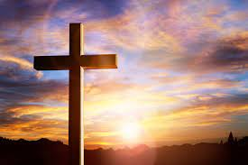

Reading – Little Wandle
The Three Little Pigs
Phase 2 Letters and Sounds
Guided Reading groups
Individual reading
Writing – Drawing Club
Mark making and drawing pictures
Writing phase 2 letters
Writing initial sounds in words
Writing my name
Writing lists and labels and stories
My news writing
CP – message centre
How do things change?
EYFS Autumn 1
RE - Creation
Who is G0d and why is he important to Christians?
Who do Christians believe created the world?
Physical Development –
FMS development
Threading and sorting
Pencil control
Scissor control
Letter formation
Construction
PE - Atlas Sports –
Moving around the space safely
Understanding risks and when to take them
Supporting your body weight with your arms
Trusting in God together, we live, learn and grow.
The Very Hungry Caterpillar
Our value is “thankfulness”
Understanding the world -What do I need to grow and how do things change?
Talk about how animals have babies which grow into adults
Talk about basic needs of animals and people.
Understand how they have changed.
Understand the terms past, present and future
Speaking and Listening
Getting to know each other
Asking questions
Learning to listen and take turns
Talking about the things you like and dislike
Speaking out in a group or in front of the class.
Re-telling stories
PSHE – SCARF
“Me and my relationships”
Classroom rules
Listening
Feelings
Our bodies
Good friends
Maths
Comparing longer and shorter
Comparing taller and shorter
Explore capacity
Explore matches
Identify size and shape
Sorting objects
Explore simple patterns
Begin counting to 5
Expressive Arts and design
Re-tell the story of The Very Hungry Caterpillar
Paint and collage pictures
Mixing colours
Use small world and imaginative resources to role play
Use construction materials for a variety of purposes
Music - Music express
My body – ”Beat

