Slide 1




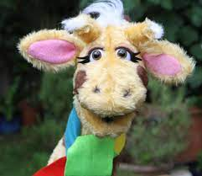
English - Drawing club
Non-fiction -
Historical themed writing
Scientific themed writing
Fiction –
Character descriptions
Re-telling story
Story innovations
SPAG
Suffixes - ed, ing, er and est endings.
Types of sentences
Using conjunctions
Maths
1 more/1 less
Number line to 20
Estimating
Missing numbers
Count groups of 10
Sequencing and compare numbers
Add by counting on
Add using number bonds
Subtract by counting back
Subtract by finding difference
“Who can help us?”
Year 1 Spring 1
Trusting in God together, we live, learn and grow
Our value this term is perseverance
Science - How do I keep myself healthy?
Talk about the importance for humans of exercise, a balanced diet and the importance of personal hygiene.
Reading
Zog and other drawing club texts
Phase 3, 4 and 5 CVC words and tricky words
Guided Reading groups
Individual reading
RE - Being Special
Who is a Muslim and how do they live?
Art and DT
Look at sculptures by known artists. Manipulate malleable materials in a variety of ways e.g. rolling and kneading.
Painting using water colours
Music – digital
Rhythm and pattern
Tempo
Talking about how music makes us feel
History
Nurturing Nurses
Investigate the life of significant individuals
Discover why they are important
Compare similarities and differences between aspects of life in different periods
PE - Atlas Sports
Use kicking skills to increase fitness
Use bouncing skills
Develop throwing skills
Develop co-ordination
Physical development CP activities
PSHE – SCARF -
Keeping safe

