Slide 1


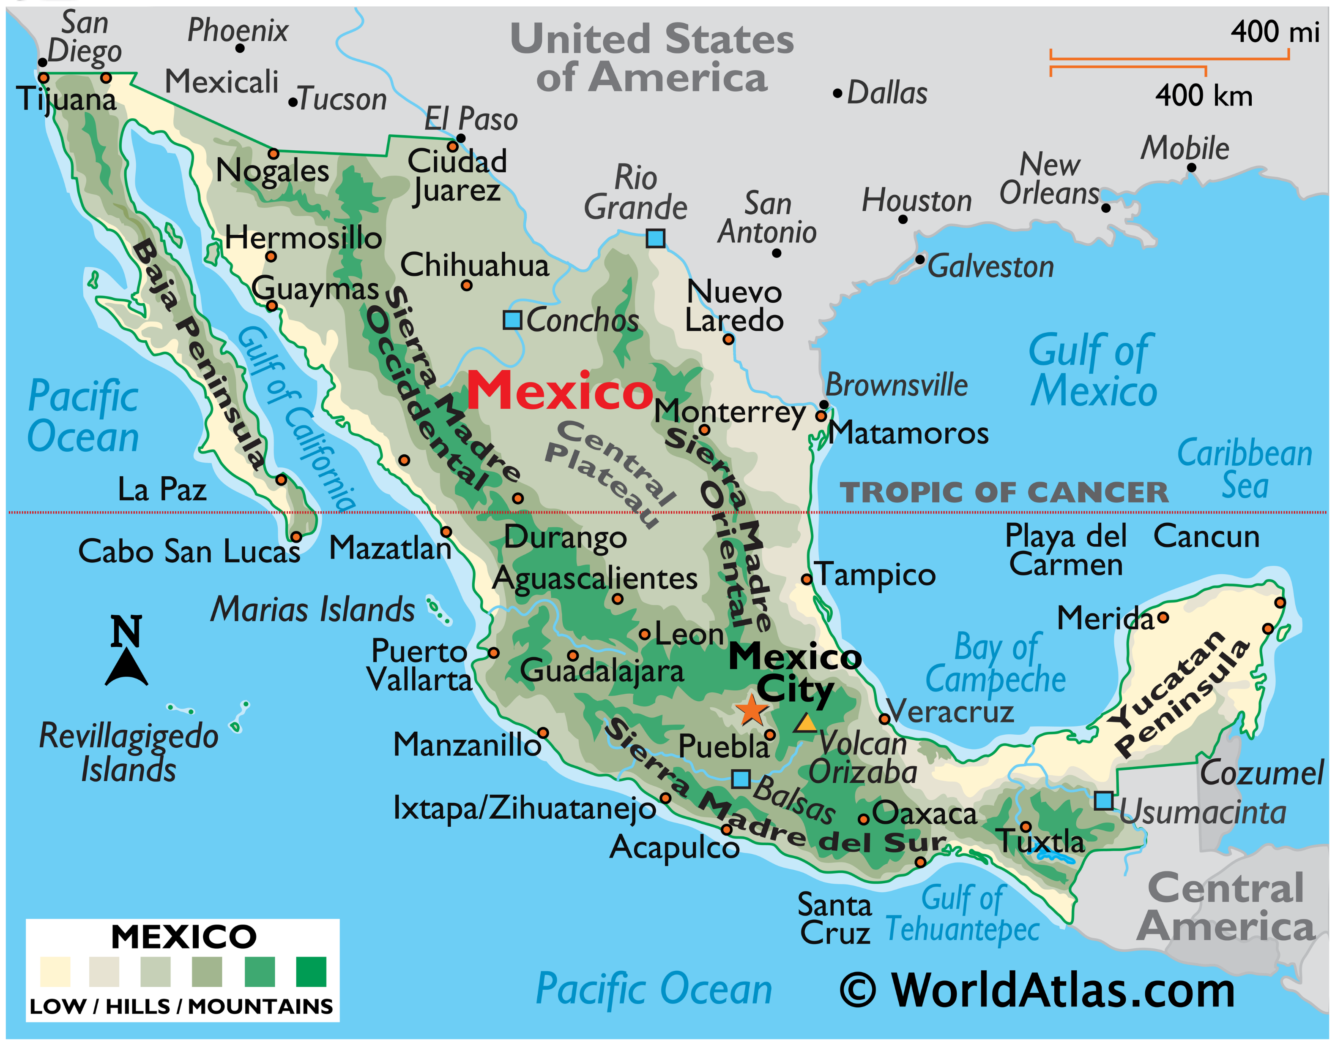
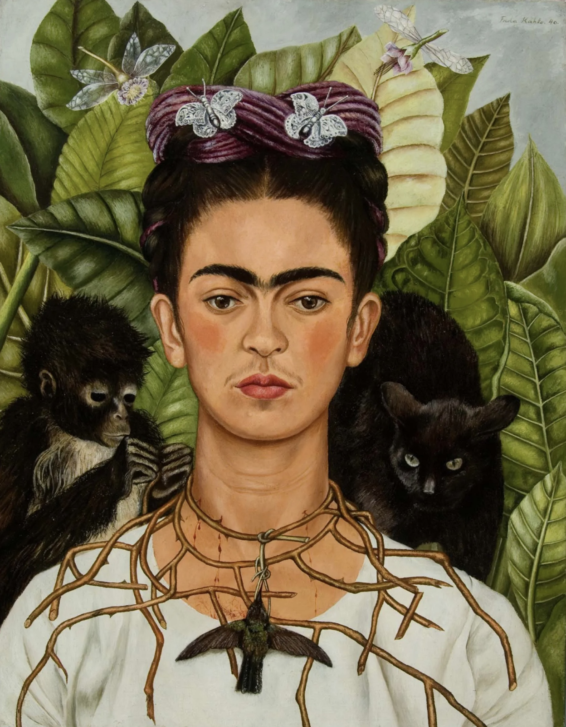
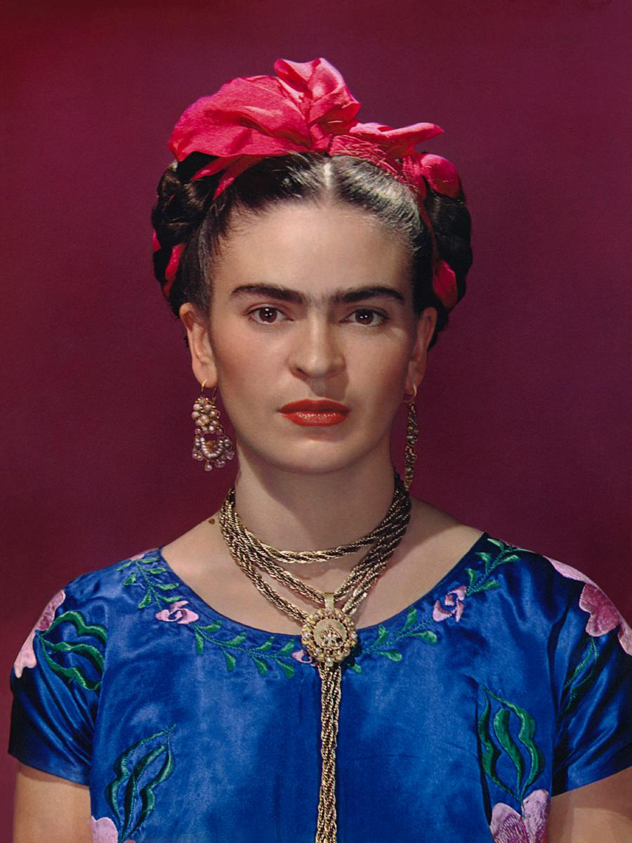
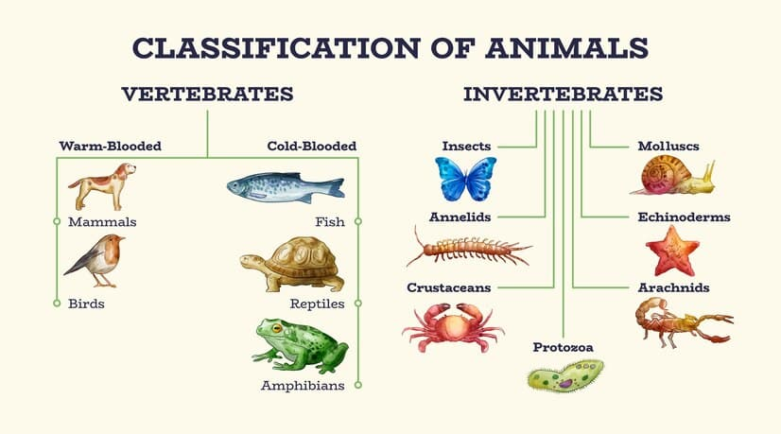

Aim High
To be a good learner I must…
Ask questions
Imagine
Motivate
Have a go
Independent
Goals
Help others
RE
Salvation
This term the children will be exploring the question: What difference does Jesus’s sacrifice make to Christians?
English
Our class book this term is The Explorer by Katherine Rundel. Alongside this we will also be reading The Water tower by Gary Crew to support the children’s writing. Our grammar focus will be on parathesis and cohesive devises.
Trusting in God together, we live, learn and grow
Our value this term is Justice
Geography
Where did the Mayans live?
To prepare for our history topic on the Mayans next term, we will be learning all about the geography of Mexico. The children will be learning about the physical landscapes and vibrant cultures of the country.
PHSE
Rights and Responsibilities
We’re learning the skills needed to develop into responsible citizens. This includes:
Beginning to understand how to look after money, including saving and spending.
Responsibilities that we have at home.
Caring for our environment.
Science
Classification
How do scientists order the living world? This term Badgers will be learning all about Charles Lienaus and how his work is still used by scientists today to understand how all life on the planet fits together.
Art
We will be learning two artist: Frida Kahlo and Gabriala Meyer. The children will be making their own Kahlo-inspired self-portraits and exploring the shape and colour of Meyer’s painting and sculpture.
Maths
In maths we will be starting the term with some learning around perimeter and area. Our next topic will be on calculating with decimals before then looking at the relationship between decimals, fractions and percentages,
Computing
We will be learning data bases.
PE
This term Atlas’ Mr E will be teaching the class….

Slide 2
National Curriculum links
Art
Pupils should be taught:
to create sketch books to record their observations and use them to review and revisit ideas
to improve their mastery of art and design techniques, including drawing, painting and sculpture with a range of materials [for example, pencil, charcoal, paint, clay]
about great artists, architects and designers in history.
PE
· Choose and combine techniques in game situations (running, throwing, catching, passing, jumping and kicking, etc.).
· Choose the most appropriate tactics for a game.
· Uphold the spirit of fair play and respect in all competitive situations.
· Lead others when called upon and act as a good role model within a team.
Science
- describe how living things are classified into broad groups according to common observable characteristics and based on similarities and differences, including microorganisms, plants and animals
- give reasons for classifying plants and animals based on specific characteristics
Working scientifically
- recording data and results of increasing complexity using scientific diagrams and labels, classification keys, tables, scatter graphs, bar and line graphs
- reporting and presenting findings from enquiries, including conclusions, causal relationships and explanations of and degree of trust in results, in oral and written forms such as displays and other presentations
- identifying scientific evidence that has been used to support or refute ideas or arguments
Computing
- Use search technologies effectively, appreciate how results are selected and ranked, and be discerning in evaluating digital content
- Select, use, and combine a variety of software (including internet services) on a range of digital devices to design and create a range of programs, systems, and content that accomplish given goals, including collecting, analysing, evaluating, and presenting data and information
Geography
Locational knowledge
- locate the world’s countries, using maps to focus on Europe (including the location of Russia) and North and South America, concentrating on their environmental regions, key physical and human characteristics, countries, and major cities
identify the position and significance of latitude, longitude, Equator, Northern Hemisphere, Southern Hemisphere, the Tropics of Cancer and Capricorn, Arctic and Antarctic Circle, the Prime/Greenwich Meridian and time zones (including day and night)
Place knowledge
understand geographical similarities and differences through the study of human and physical geography of a region of the United Kingdom, a region in a European country, and a region within North or South America Human and physical geography
describe and understand key aspects of: physical geography, including: climate zones, biomes and vegetation belts, rivers, mountains, volcanoes and earthquakes, and the water cycle.
human geography, including: types of settlement and land use, economic activity including trade links, and the distribution of natural resources including energy, food, minerals and water
Geographical skills and fieldwork
- use maps, atlases, globes and digital/computer mapping to locate countries and describe features studied

